Slide 1
Bike Rides around the Bay
Blaine Nelson

Slide 2
Outline
Intro to Cycling
Biking Routes
Berkeley
East Bay
San Francisco
Marin County
North Bay
South Bay
Intro to Touring in California

Slide 3
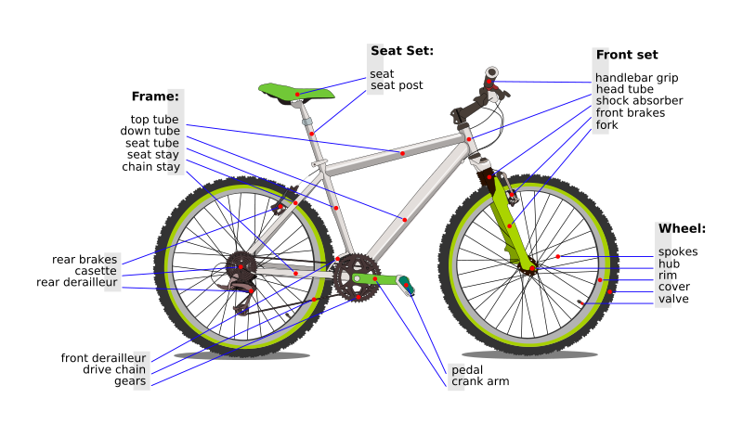
Bicycle Terms

Slide 4
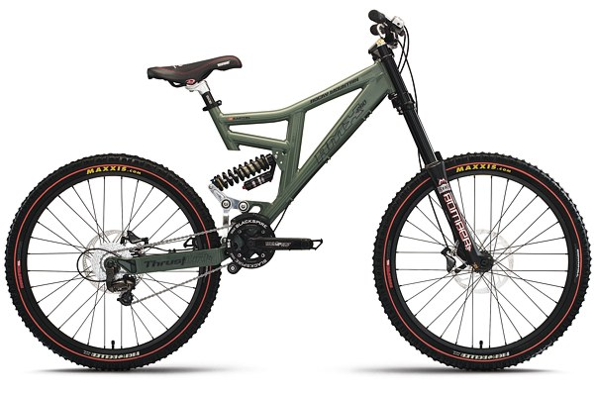
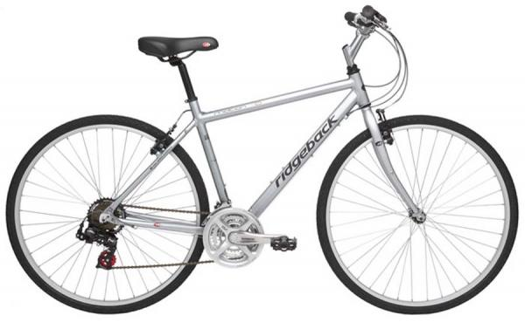
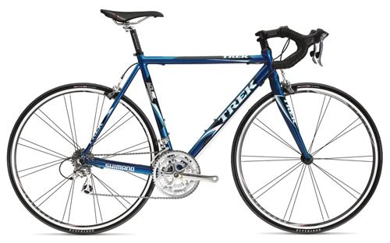
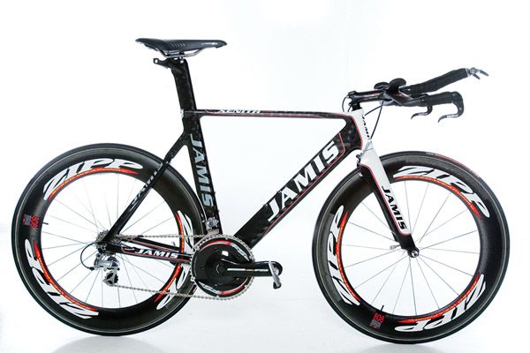
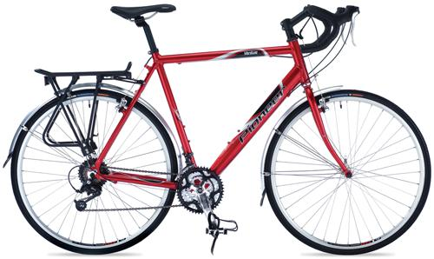
Geometry Mountain, Hybrid, Road, Triathlon, Touring

Slide 5
Basic Bike Tips
WEAR A HELMET
Oil your chain, but don’t over-oil it
Periodically check tires for glass
Repair/Replace breaks & break-cables
When something sounds wrong, something probably is wrong
Be prepared to adjust your plans

Slide 6
Rides in Berkeley & Connections
A Beginners Guide to Berkeley Commuting and Recreation

Slide 7
Berkeley Campus
Link to Map

Slide 8
Berkeley Marina
Ride Stages:
Bay Trail Emeryville to Albany
Eastshore Hwy
Bay Trail Albany to Richmond
Statistics:
Distance: 8.8 miles
Ascent:
Descent:
Difficulty: Easy
Notes:
Accessible via the Berkeley walking bridge, this route is great for beginning cyclists. Its flat, it has many dedicated bike paths and it has views of the Bay & Golden Gate bridge (Also connects to Berkeley Marina, Cesar Chavez Park, and Albany bulb). It’s also great for speed. Watch cross winds and car crossings.
Link to Map

Slide 9
Berkeley Hills
Grizzly Peak/Skyline run along the ridge and serve as the start of many rides in East Bay
There are several ascents to the ridge
Marin - 2.5 miles (map)
Spruce – 2.5 miles (map)
Euclid – 2.3 miles (map)
La Loma – 1.6 miles (map)
Centennial – 2.3 miles (map)
Claremont – 4.7 miles (map)
Hiller Dr. – 4.7 miles (map)
Old Tunnel – 7.3 miles (map)

Slide 10
Ridge Running
Riding across the Berkeley Hills using Grizzly Peak and Skyline
relatively flat
spectacular views
not many cars on off-hours but beware of motorcycles
Statistics:
Distance: 13.5 miles
Ascent:
Descent:
Difficulty: beginner
Notes:
A few sharp curves. Beware of steep descents coming down the hill. Great bay views in October/May.
Link to Map

Slide 11
San Pablo – Gateway to North Bay?
Ride Stages:
San Pablo Ave.
Connects to the Carquinez bridge bikeway (to Vallejo)
Statistics:
Distance: 20 miles
Ascent:
Descent:
Difficulty: Easy
Notes:
Taking San Pablo Ave. is the simplest way to connect to North Bay & leads directly to the Carquinez bridge. In Berkeley & Richmond the ride is flat but plagued by stop lights. In the Hercules Rodeo area, there are several medium sized hill climbs. Road conditions and traffic are poor.
Link to Map

Slide 12
The “Key” Route to N.B.
Ride Stages:
Berkeley/Albany side roads
San Pablo Dam Rd./Appian Way
San Pablo Ave.
Connects to the Carquinez bridge
Statistics:
Distance: 19.7 miles
Ascent:
Descent:
Difficulty: Beginner
Notes:
The “Key” Route avoids the busy part of San Pablo Rd., but it’s complicated to remember all the roads. As with San Pablo, the route is relatively flat with fewer cars & better roads. This is my preferred route North.
Link to Map

Slide 13
Oakland/Hayward routes
Ride Stages:
Shattuck/Telegraph into Oakland
International/Bancroft
Hesperian/Union City Blvd.
Paseo Padre/Marshlands connects to the Dumbarton bridge
Statistics:
Distance: 31.2 miles
Ascent:
Descent:
Difficulty: Intermediate
Notes:
I don’t know of a great way through Oakland, but this route is okay. The traffic is bad and the roads are poor. It does connect to South Bay via the Dumbarton bridge. Southern winds are fierce in the late afternoon.
Link to Map

Slide 14
Wheel Repair Tips

Slide 15
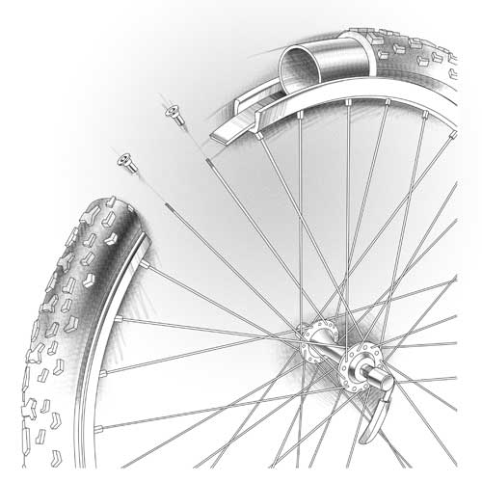
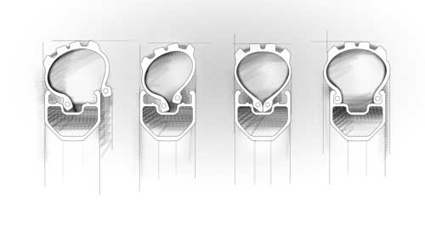
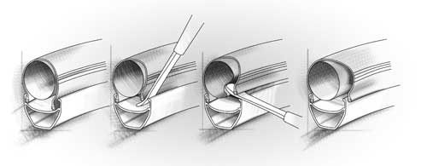
Bicycle Wheels
Cross Section of a wheel
Tires & Tube Seating
Illustrations from http://www.technical-illustrations.co.uk/bike-project.html

Slide 16
East Bay

Slide 17
Crossing the Berkeley Hills
Routes into East Bay
Wildcat Canyon – 6.0 miles (map)
Shasta – 4.4 miles (map)
South Park Dr. – 5.1 miles (map)
El Toyonal – 4.2 miles (map)
Pinehurst Rd. – 5.7 miles (map)
Redwood Rd. – 6.9 miles (map)
Description
There are several descents that cross Berkeley hills from the backbone provided by Grizzly Peak & Skyline. These routes tend to be more steep and dangerous the closer they are to toward Orinda. While all these rides are winding roads with a few sharp turns, El Toyonal stands out as the most treacherous and you can easily melt your brakes.

Slide 18
Pinehurst-Redwood
Ride Stages:
Descend from Skyline on Pinehurst (alternatively take Skyline directly to Redwood).
Connect onto Redwood Rd.
Take Redwood into Castro Valley (BART Connection)
Statistics:
Distance: 17.2 miles
Ascent:
Descent:
Difficulty:
Notes:
Redwood Rd. is one of the most serene areas in East Bay. There are 3 climbs on this ride. The middle climb is long and tedious.
Link to Map

Slide 19
San Pablo Dam Loop
Ride Stages:
Euclid Climb (or other)
Wildcat Canyon Rd.
San Pablo Dam Rd.
Key Route
Statistics:
Distance: 26.7 miles
Ascent:
Descent:
Difficulty:
Notes:
BART options in Orinda, Richmond, & El Cerrito. The wind is against you in the afternoon, North & South bound.
Link to Map

Slide 20
Three Bears Loop
Ride Stages:
San Pablo Dam Rd.
Baby Bear
Mama Bear
Papa Bear
Statistics:
Distance: 18.8 miles
Ascent:
Descent:
Rating:
Notes:
As the name suggests, this loop has 3 distinct hill climbs. The 1st is a baby, the 2nd is a long grueling climb. The 3rd is a shorter hard climb but has a superb descent on the other side.
Link to Map

Slide 21
Walnut Creek, Pittsburg?

Slide 22
Danville Blvd.

Slide 23
Mount Diablo
Ride Stages:
Moraga to Walnut Creek
Walnut Creek to Mt. Diablo Park
Lower Diablo to Ranger Station
Ranger Station to Summit
North Entrance:
Distance: 21.6 miles
Ascent:
Descent:
Difficulty:
South Entrance:
Distance:
Ascent:
Descent:
Difficulty:
Link to Map
Notes:
The highest peak in the East Bay in Mt. Diablo summiting at 3900 ft. This ride begins after crossing the Berkeley Hills, but alternatively you can start in Walnut Creek. Also, there is a North and South route up the mountain.
The climb up to Diablo is diabolical. During the summer, Walnut Creek is scorching and during the winter, ice and snow are possible. The climb itself begins as a series of foothills that progressively become larger. The lower part of the mountain is a long droll that gradually flattens out. However, the last 2 ½ miles (beginning at the Ranger Station) increase the grad of the climb. The final 100 m is sharp climb to the summit that saps your last strength.

Slide 24
Morgan Territories
Ride Stages:
Walnut Creek & Clayton
Morgan Territories Rd.
Camino Tassajara
Danville Blvd.
Statistics:
Distance: 49.9 miles
Ascent:
Descent:
Difficulty: Hard
Notes:
Morgan Territories is a remote loop that has 1 primary climb for 8+ miles & a spectacular descent on the other side. The loop should be traversed clockwise! Water at the top of the climb & BART in Dublin or Walnut Crk.
Link to Map

Slide 25
Palomares Rd.
Ride Stages:
Dublin-Pleasanton BART to Dublin
Foothill & Niles Canyon Rd. (exit to Fremont BART)
Palomares Rd. to Castro Valley (connects to BART or Redwood)
Statistics:
Distance: 28 miles
Ascent:
Descent:
Difficulty: Intermediate
Notes:
Palomares is a remote road with low traffic and an astounding descent toward Castro Valley. This ride has multiple bail points and can be connected to Morgan Territories or Redwood-Skyline.
Link to Map

Slide 26
Morgan Terr. - Palomares Century
Ride Stages:
Old Tunnel + Pinehurst + Olympic
Morgan Territories
Palomares Route
Redwood + Skyline + Claremont
Statistics:
Distance: 102 miles
Ascent:
Descent:
Difficulty: Advanced
Notes:
This would be an awesome East Bay century that combines 3 of my favorite routes into a single loop. Bail points in Walnut Creek, Dublin, Fremont, & Castro Valley. Who’s in?
Link to Map

Slide 27
San Francisco
Fixie Heaven

Slide 28
Twin Peaks & Market Loop
Ride Stages:
Market to Haight St.
Ashbury & Twin Peaks
Portola Dr. & Market
Statistics:
Distance: 8.2 miles
Ascent:
Descent:
Difficulty: Easy-Intermediate
Notes:
Be careful on Market. Haight St. has 2 hills, and there is a 3rd onto Twin Peaks. The peaks provide a perfect view of the city on a clear day. The descent down Market is astounding but turns are sharp & cars may stop unexpectedly.
Link to Map

Slide 29
The Presidio & Ocean Hwy
Ride Stages:
Embarcadero & Wharf
Crissy Field
Lincon Blvd
Great Hwy on Ocean Beach
Statistics:
Distance: 16.3 miles
Ascent:
Descent:
Difficulty: Beginner
Notes:
This ride is fairly flat. The Presidio is a fairly quiet area and the descent down to Ocean Beach is great. The Great Hwy is a long flat road that’s great for sprints. You can catch BART in Daly City to go back.
Link to Map

Slide 30
Golden Gate Bridge
Ride Stages:
Embarcadero & the Wharf
Crissy Field
Golden Gate Bridge
Statistics:
Distance: 8.8 miles
Ascent:
Descent:
Difficulty: Beginner
Notes:
This ride has very mild climbs & minor car traffic. Golden Gate Bridge is also a gateway to most Marin County rides (no bikes on the Richmond bridge). There are many tourists on this route, though on poor bikes (Blazing Saddles). Bridge bikeway is narrow & windy.
Link to Map

Slide 31
Marin County
The birthplace of mountain biking

Slide 32
Hawk Hill & Point Bonita
Ride Stages:
Climb Hawk Hill
Descend Conzelman Rd. (Steep) to Point Bonita
Bunker Rd. loops back to bridge
Statistics:
Distance: 7.7 miles
Ascent:
Descent:
Difficulty: Easy-Intermediate
Notes:
Hawk Hill provides excellent views of the Golden Gate & SF. The climbs are steep but worth it. Point Bonita & Rodeo Lagoon are quiet serene areas. On the reverse side, there is a long tunnel – it is 1-way so don’t run the light.
Link to Map

Slide 33
Mountain Biking in Marin
Routes:
There are a variety of bike-friendly trails in Marin, but I’m only familiar with a fraction of them. My favorite route winds through the hills between Rodeo Lagoon, Tennessee Beach and Muir Beach. Enjoy Golden Gate Recreation Area and the Pacific cliffs and beaches.
Link to Map

Slide 34
Saulsilito/Mill Valley
Ride Stages:
Descend into Sausalito
Bridgeway runs along waterfront
Bike path runs to Mill Valley
Statistics:
Distance: 6 miles
Ascent:
Descent:
Difficulty: Beginner
Notes:
This is a really enjoyable flat ride that you can extend to Tiburon (5mi). The bike path is great. Traffic is light and the roads are in good condition. This also acts as the primary conduit to the rest of Marin County (e.g. Hwy 1). Ferry service in Sausalito/Tiburon to SF is a backup.
Link to Map

Slide 35
Mount Tam
Ride Stages:
Sausilito bikepath + Hwy 1
Panoramic Hwy across ridge
Climb to Tam summit
Statistics:
Distance: 9.6 miles
Ascent:
Descent:
Difficulty: Intermediate
Notes:
This is a nice climb from sea level to 2500’. Hwy 1 can be crowded on weekends. Panoramic Hwy has nice views of Muir Woods and Tam provides nice Bay views on a clear day. Also provides an alternative descent into Stinson Beach on Panoramic.
Link to Map

Slide 36
Hwy 1 to Stinson Beach/Bolinas/Point Reyes
Ride Stages:
Sausilito bikepath + Hwy 1
Continue on Hwy 1 ad nausem
Statistics:
Distance: 7/12/19/28 miles
Ascent:
Descent:
Difficulty: Intermediate-Advanced
Notes:
Hwy. 1 North of SF is a must for scenic long rides. The 1st 11 miles have 2 large climbs and rolling hills. Between Stinson Beach & Bolinas is an awesome flat road along Bolinas Lagoon. After that it gets tedious and tiring with a few extra climbs and heavy winds. Panoramic is alternative to Stinson Beach and Sir Francis Drake is alternative to Point Reyes.
Link to Map

Slide 37
Mill Valley to Fairfax
Ride Stages:
Sausilito bikepath
Camino Alto/Corte Madera/Magnolia
Sir Francis Drake Blvd.
Statistics:
Distance: 9.2 miles
Ascent:
Descent:
Difficulty: Beg. - Intermediate
Notes:
Camino Alto/Corte Madera are a large climb with sharp curves and blind driveways. Sir Francis Drake has heavy traffic, but I don’t know of a better route yet.
Link to Map

Slide 38
Fairfax-Bolinas
Ride Stages:
Sausilito bikepath to Sir Francis Drake Blvd.
Sir Francis Drake to Fairfax
Fairfax-Bolinas route
Statistics:
Distance: 24.5 miles
Ascent:
Descent:
Difficulty: Intermediate
Notes:
This is one of my favorite rides. Once you leave Fairfax, the road has little to no traffic and beautiful lakeside scenery. There are 2 major climbs and a fast windy descent to the ocean. From Bolinas, loop back around on Hwy 1 to complete the ride.
Link to Map

Slide 39
Point Reyes (SFD route)
Ride Stages:
Sausilito bikepath to Sir Francis Drake Blvd.
Sir Francis Drake to Olema
Continue on SFD into Point Reyes
Statistics:
Distance: 44.1 miles
Ascent:
Descent:
Difficulty: Advanced
Notes:
I prefer this ride to Point Reyes. SFD has heavy traffic on some parts but is relatively flat. However, Point Reyes itself is rolling hills ad nausem and head winds in both directions. The scenery is moderate.
Link to Map

Slide 40
Connecting to North Bay
Ride Stages:
Sausilito bikepath to Sir Francis Drake Blvd.
Sir Francis Drake to San Rafael
Secret bike path to Novato
Statistics:
Distance: 19 miles
Ascent:
Descent:
Difficulty: Intermediate
Notes:
This ride is a great way to circle North Bay. There are only 2 moderate climbs. The only problem is finding the unmarked secret bike path that parallels the 101. Pay close attention!
Link to Map

Slide 41
North Bay

Slide 42
Napa Valley
Ride Stages:
Use Carquinez bridge into Vallejo
Hwy 29 North
Hwy 221/Silverado Tr. North
Statistics:
Distance: 28.3 miles
Ascent:
Descent:
Difficulty: Intermediate
Notes:
This ride is a fun flat ride into wine country. Can be extremely hot in afternoon. A second route that parallels Hwy 29 proved to have poor roads – I’d stick to Silverado. I have yet to explore Lake Hennessey or Sonoma County, but they seem interesting.
Link to Map

Slide 43
Hwy 37 – East Bay to Marin
Ride Stages:
Use Carquinez bridge into Vallejo
Take Mare Island Causeway
Hwy 37 (connects to bikepath in Novato to go South)
Statistics:
Distance: 24.5 miles
Ascent:
Descent:
Difficulty: Intermediate
Notes:
This ride is the fast way across North Bay, but it wasn’t intended for bikes. The scenery is beautiful undeveloped marsh, but you’re on a 55mph Hwy shoulder & the 3 bridges have narrow shoulders. Connects to Marin County via the “secret bikepath”.
Link to Map

Slide 44
Bay Trail in North Bay

Slide 45
South Bay

Slide 46
El Camino Real
Ride Stages:
El Camino Real (connects to Mission St. or Daly City BART)
Statistics:
Distance: 39 miles
Ascent:
Descent:
Difficulty: Intermediate
Notes:
El Camino Real is a backbone route in South Bay that can be used to reach other routes. It’s easy to use as a backup route. However, road conditions and traffic levels are poor.
Link to Map

Slide 47
Milpitas & San Jose
Ride Stages:
Fremont/Warm Springs/Milpitas Blvd.
Tasman Dr.
Great American Pkwy/Bowers
Statistics:
Distance: 27.6 miles
Ascent:
Descent:
Difficulty: Easy-Intermediate
Notes:
This route connects to Union City routes & BART. The road quality here is astounding. No real hills, but the Southern wind is crippling in the late afternoon.
Link to Map

Slide 48
Dumbarton Bridge
Ride Stages:
Union City Blvd. & Marshlands
Dumbarton Bridge
Willow Rd. into Palo Alto
Statistics:
Distance: 13.3 miles
Ascent:
Descent:
Difficulty: Easy
Notes:
From East Bay, this is the fast way to Palo Alto by bike (BART/Caltrain is an alternative). No real hills, but the Southern wind is crippling in the late afternoon. It’s a very industrial ride though and the Dumbarton bridge stinks.
Link to Map

Slide 49
Page Mill Rd.
Ride Stages:
Connect to Page Mill via El Camino, Middlefield, etc.
Climb Page Mill Rd.
Statistics:
Distance: 12.5 miles
Ascent:
Descent:
Difficulty: Intermediate
Notes:
I’ve never climbed all the way to Skyline, but I’ve descended it. The road surface & views are immaculate. The curves are sharp and can be dangerous, but it’s a great ride.
Link to Map

Slide 50
Skyline
Ride Stages:
Connect to Skyline via Page Mill, Hwy 9, etc.
Ride Skyline to your heart’s content
Statistics:
Distance: 38.9 miles
Ascent:
Descent:
Difficulty: Intermediate
Notes:
I haven’t been on all of Skyline, but the views I’ve seen are pretty spectacular. The road seems good but the shoulder is small. Watch for joy-riders and tourists especially on weekends.
Link to Map

Slide 51
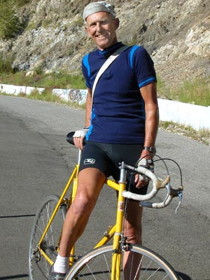
Hwy 9 to Santa Cruz
Ride Stages:
Connect via Saratoga Ave.
Hwy 9 (can take Big Basin Way 236 as detour)
Statistics:
Distance: 40.7 miles
Ascent:
Descent:
Difficulty: Advanced
Notes:
Saratoga can have heavy traffic. The 6 mile climb up to 2600’ is a bear, but the descent is long and fun with good road conditions and beautiful countryside – take 236 as an alternate route through Big Basin Redwoods park. There are no good bail out plans here.
Link to Map

Slide 52
Touring in California
What little I know about touring and my touring trips

Slide 53
Around the Bay in a Day
Link to Map

Slide 54
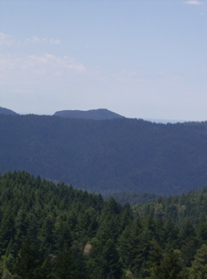
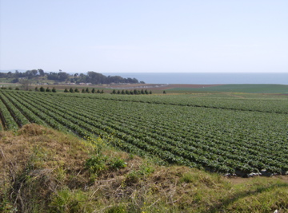
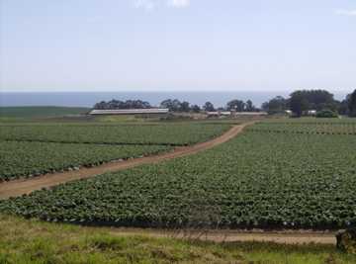
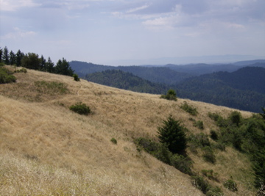
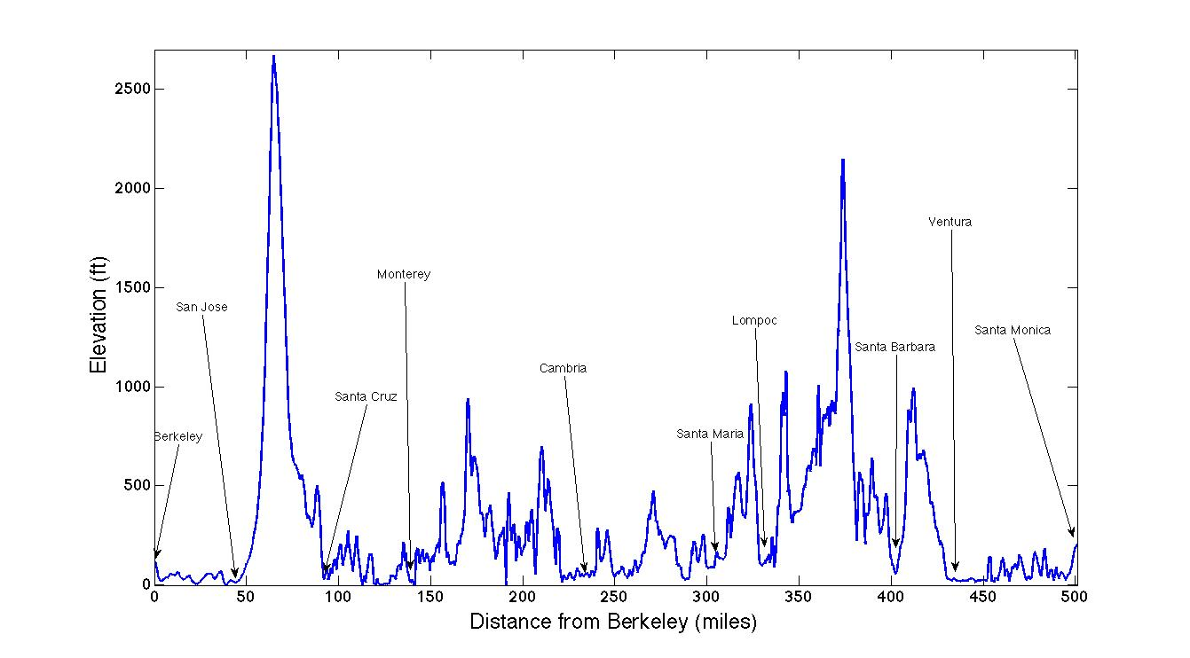
Berkeley to Los Angeles
This summer, I biked down to LA in a trip I planned to take in 3 day-long stages:
Berkeley to Monterey
Monterey to Lompac
Lompac to LA
Day 1 (Berkeley to Monterey)
Distance: 136 miles
Challenges:
Waking up + unexpected flat
Tremendous heat (93-103 F)
T-storms and mild rain
Notable Events
Unbearable heat in San Jose
Great descent into Santa Cruz
T-storms and fires in the distance
Ocean + Strawberry fields!
Scores of bikers going through Monterey
Link to Map

Slide 55
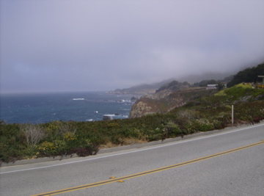
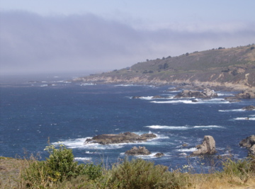
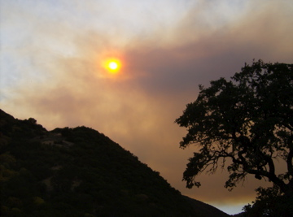
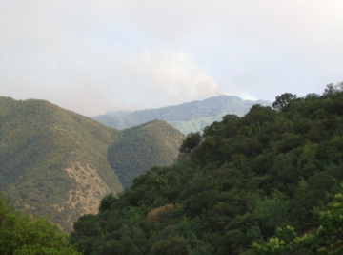
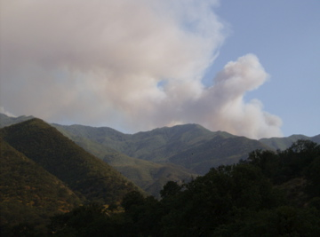
Berkeley to Los Angeles
Day 1 (Monterey to Lompoc)
Distance: 196 miles
Challenges:
Early wake up
Maintaining fast pace
Powering through hills while maintaining energy
Notable Events
Found a pseudo-shortcut!
Big Sur in the early morning
Closures & Smoke!
Revised Day 2 (Monterey to King City)
Distance: 127 miles
Challenges:
Doubling back + wind & new route
Unexpected hill crossing
Heat and Smoke
Notable Events
Heat and hills of the valley
All alone & more smoke
Hills on fire
Link to Map 1
Link to Map 2

Slide 56
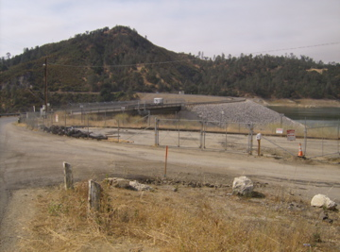
Berkeley to Los Angeles
Revised Day 3 (King City to Solvang)
Distance: 188 miles
Challenges:
Finding the route
Unexpected detours
Rolling hills on Paso Robles
Crossing back to the ocean
Making up time
Navigating a deserted road in pitch black
Notable Events
Closures & Smoke!
Heat and hills of the valley
Finding the best way back to the ocean
Returning to the cool ocean
Taking the 101
Getting booted off the 101
Crossing a hill in the dark with perfect night sky
Link to Map

Slide 57
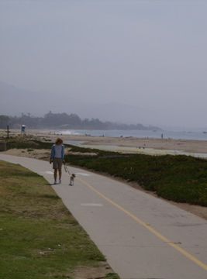
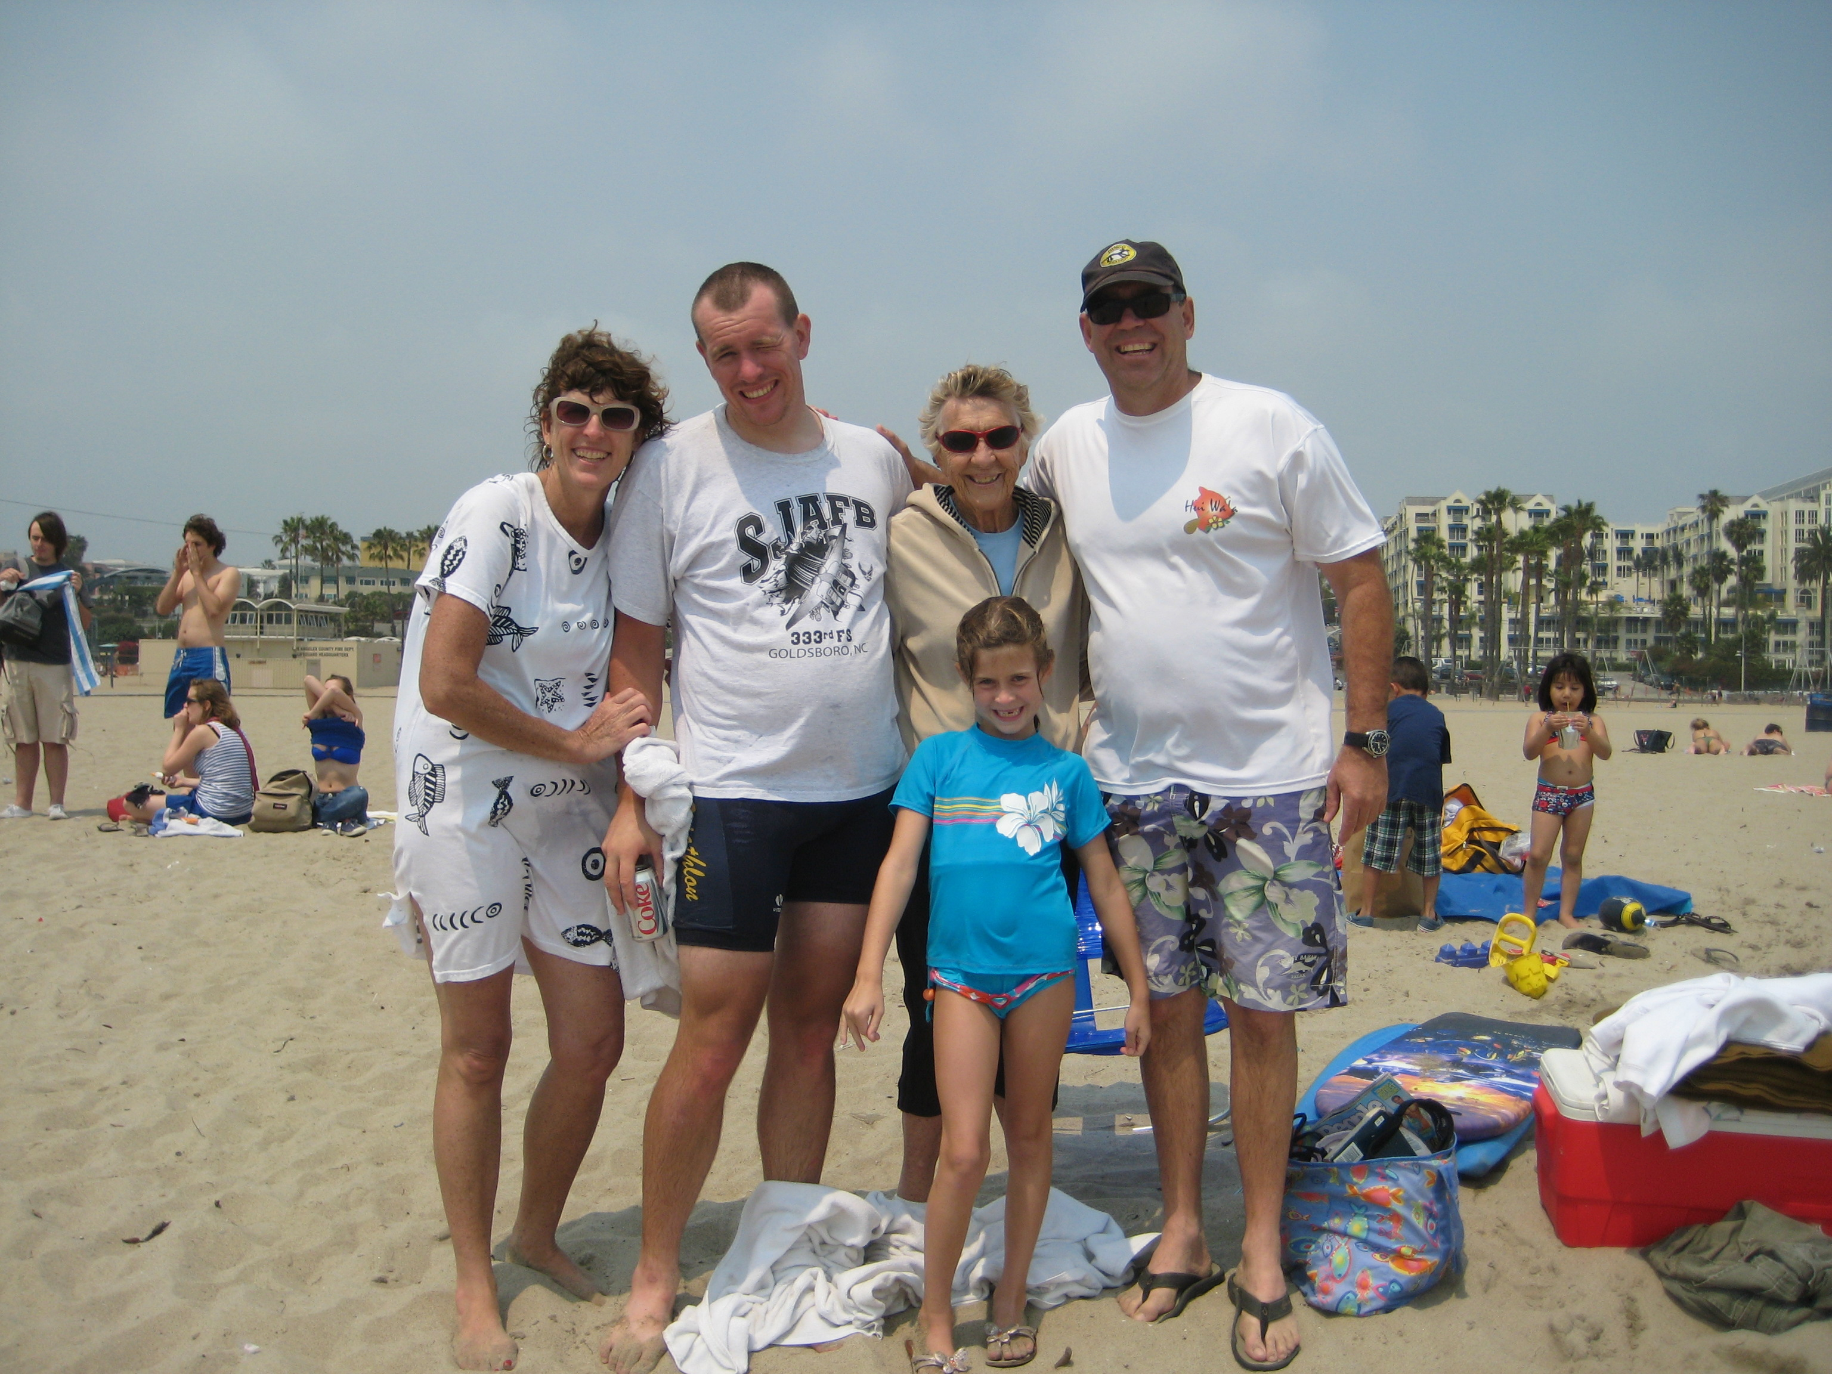
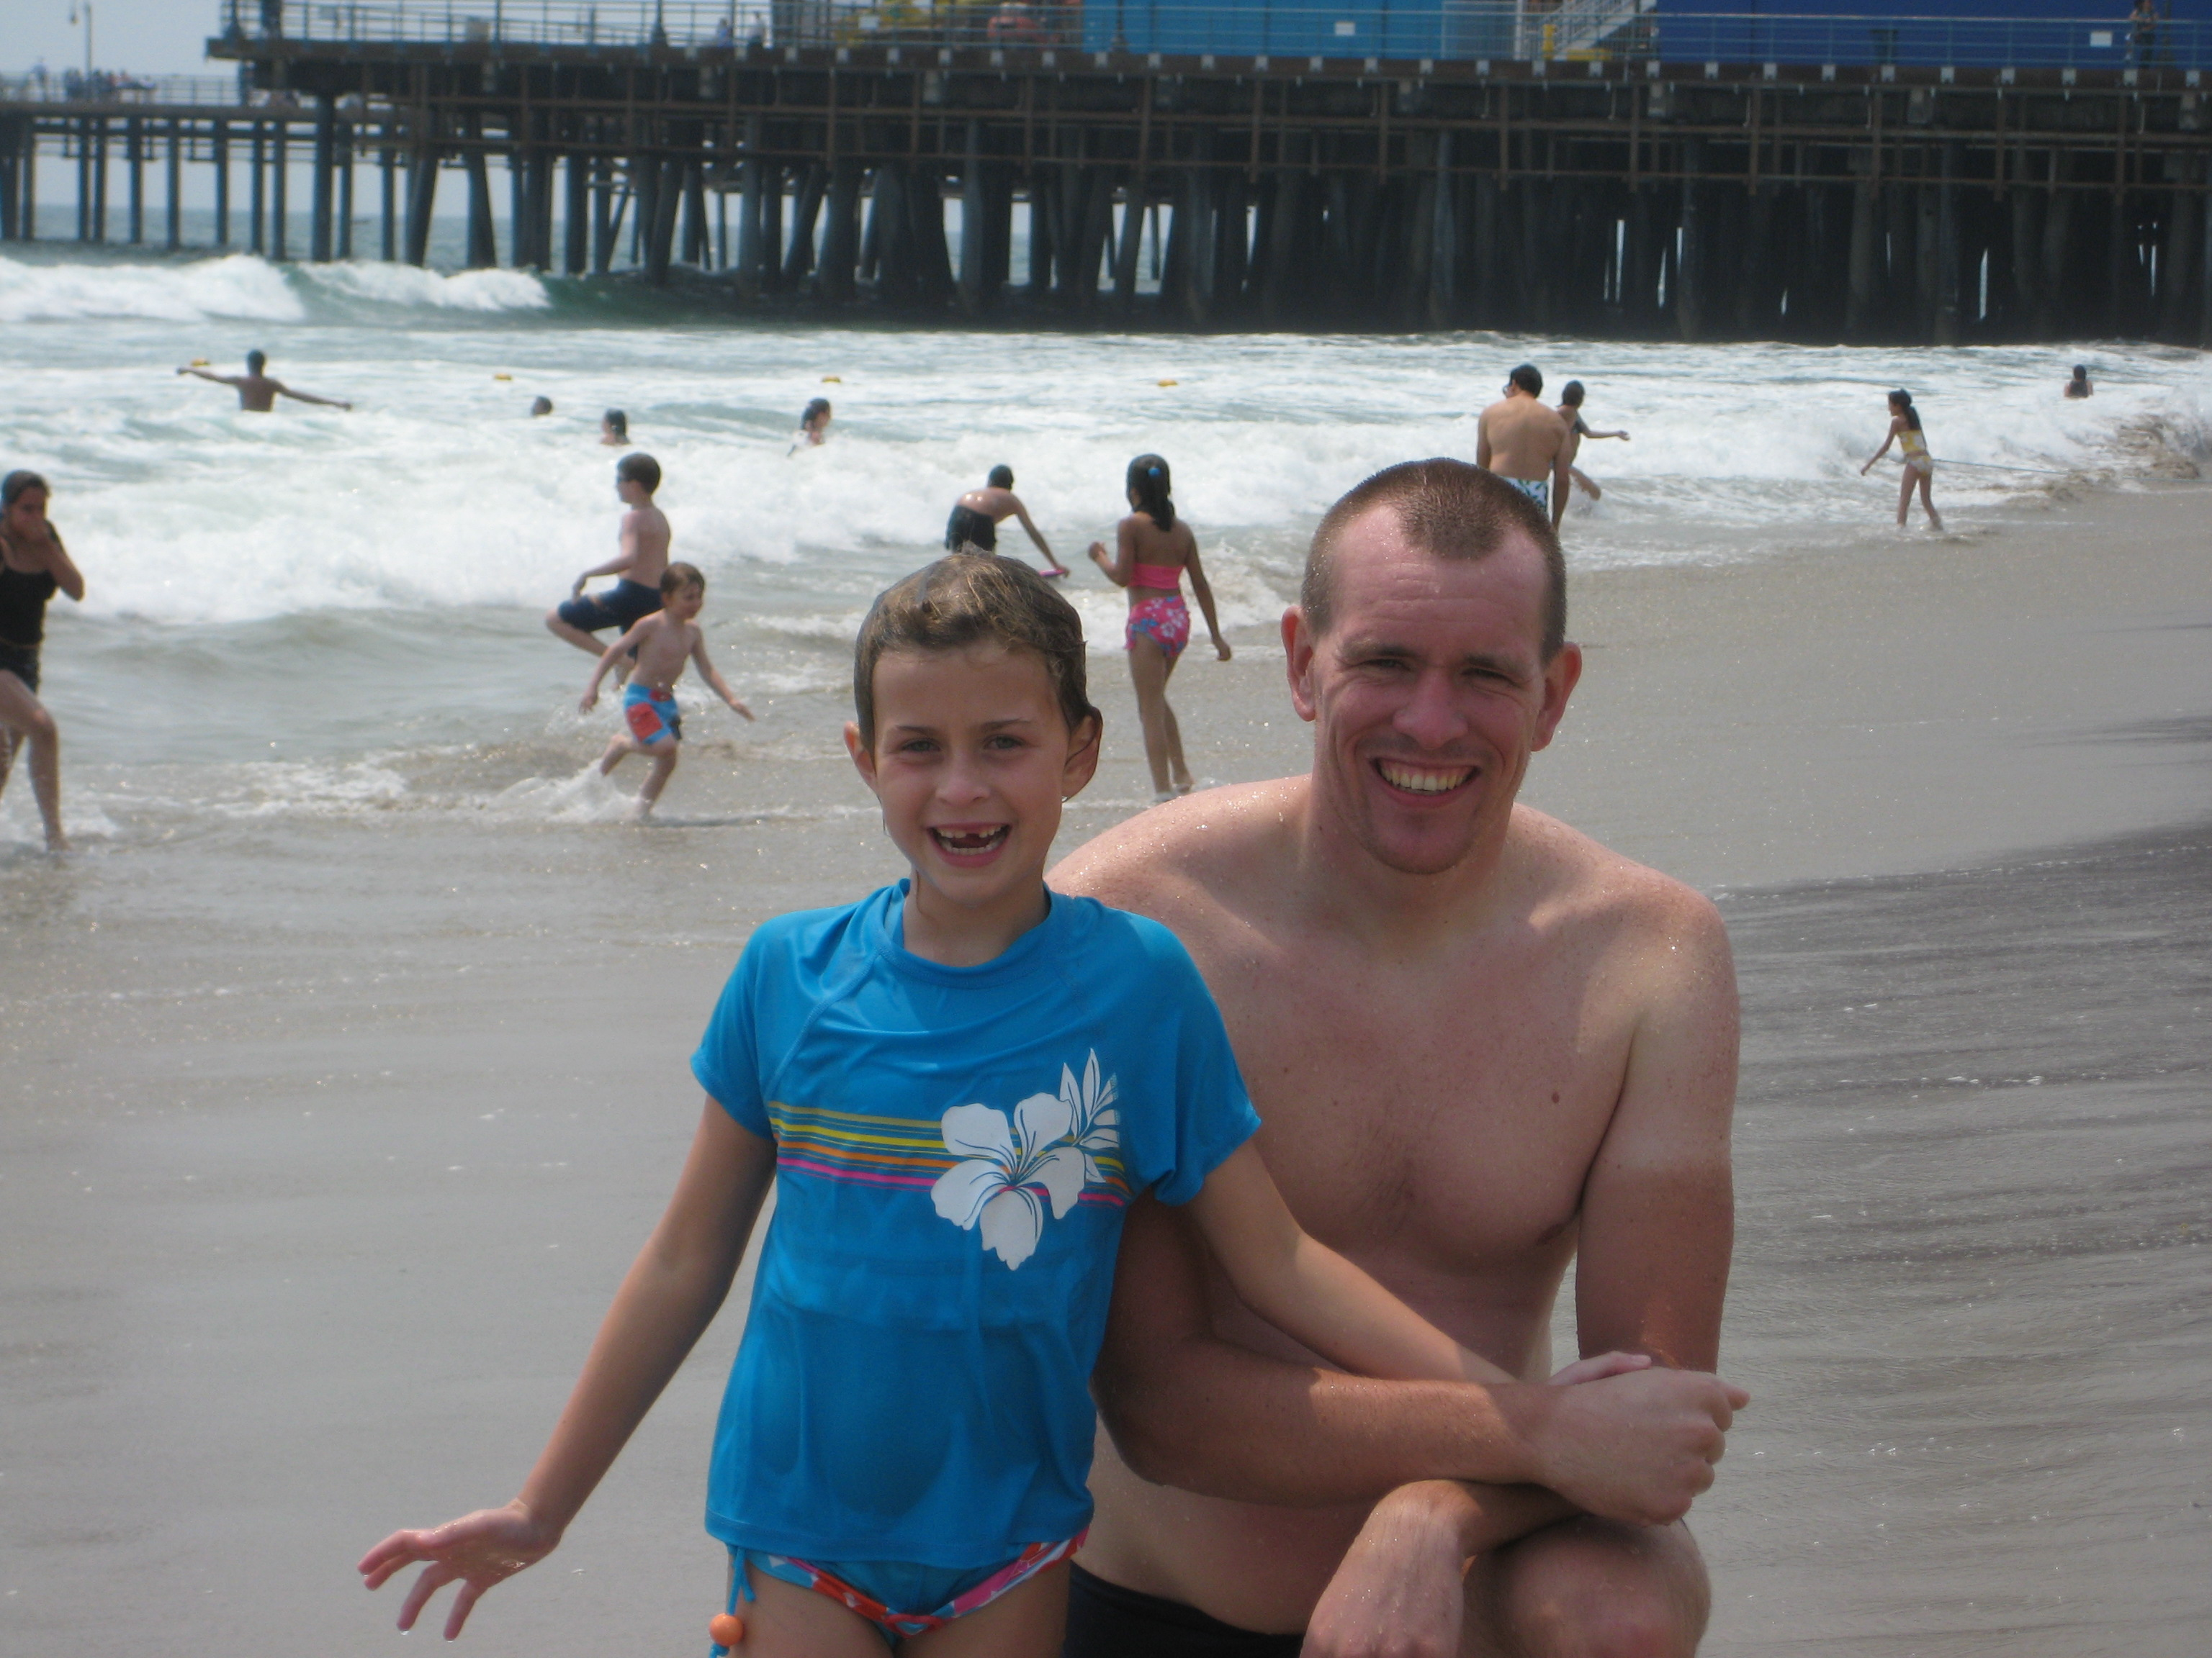
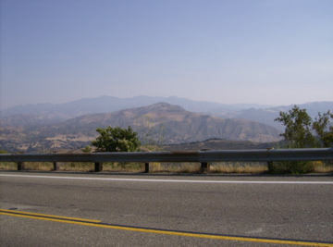
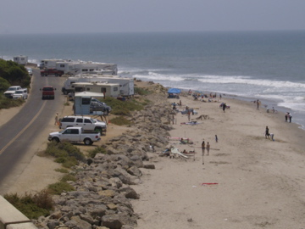
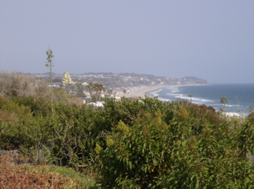
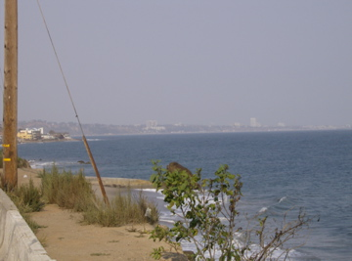
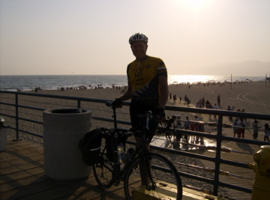
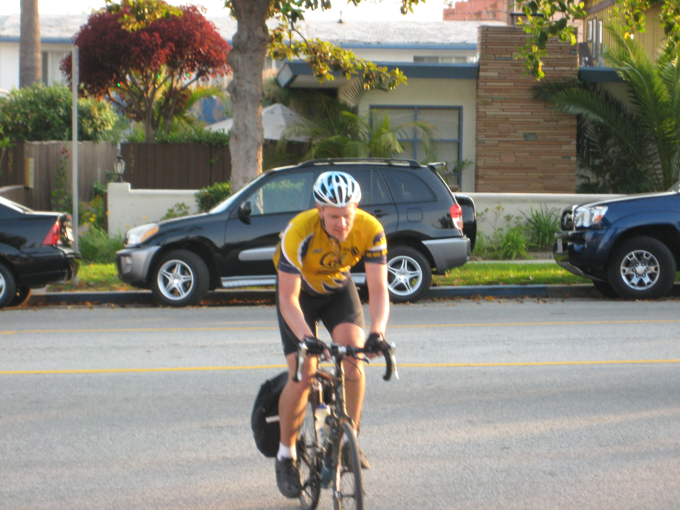
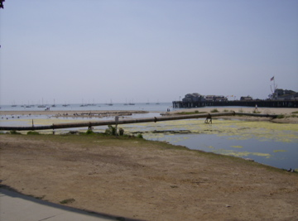
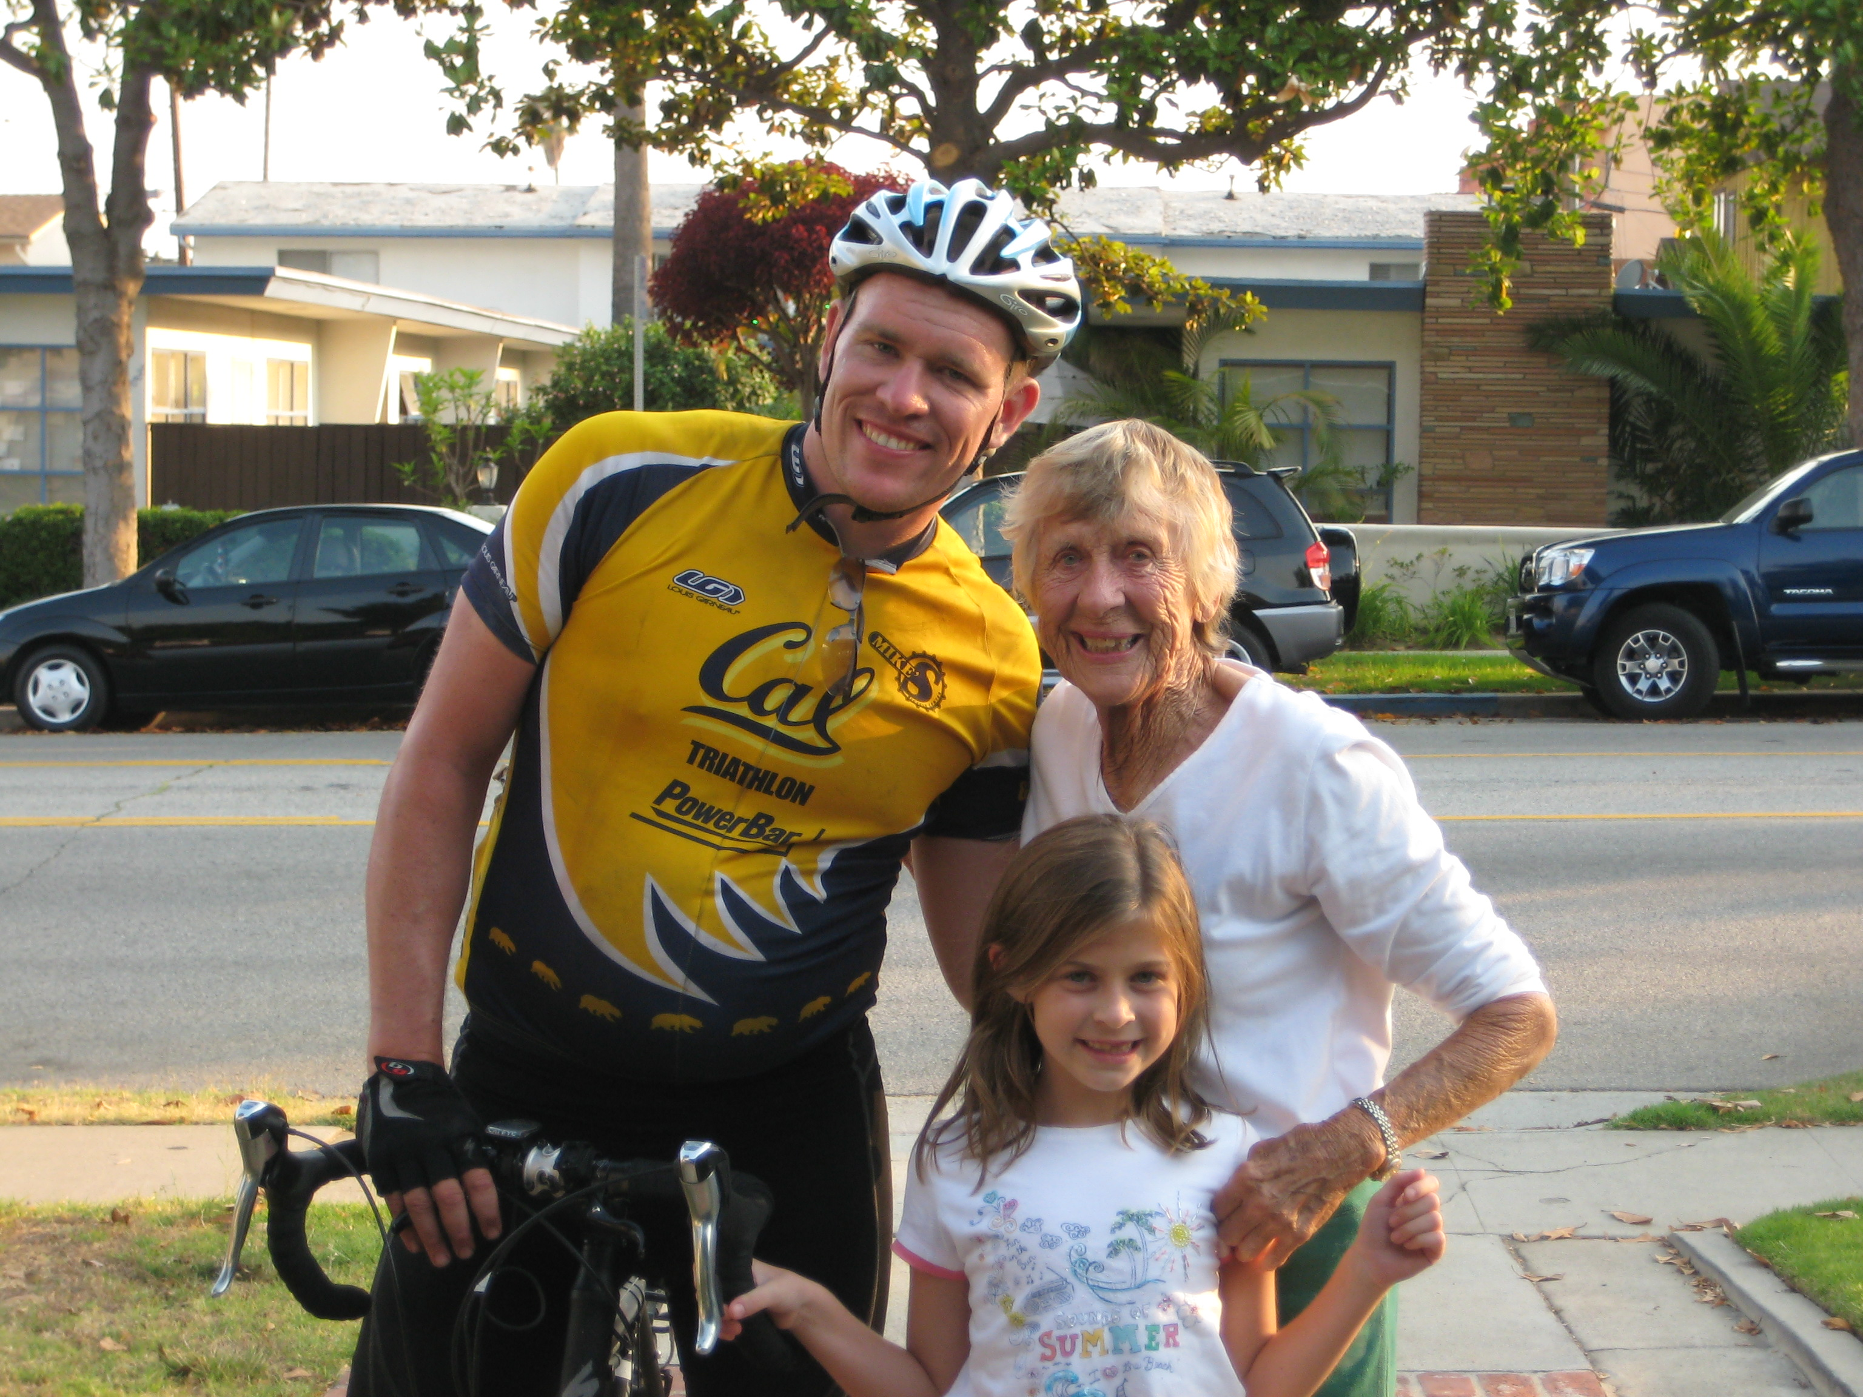
Berkeley to Los Angeles
Day 4 (Solvang to Los Angeles)
Distance: 122 miles
Challenges:
Waking up
Getting on the bike
San Marcos Pass
Notable Events
Bridge with tiny shoulder
Crossing back over to the ocean
Avoiding Casitas Pass via Ocean bikeway
Rejoining Hwy 1
Joy of passing through Malibu and seeing Santa Monica Pier
Link to Map

